Slide 1
Chapter 9: Data Management Layer Design

Slide 2
Objectives
Become familiar with several object-persistence formats.
Be able to map problem domain objects to different object-persistence formats.
Be able to apply the steps of normalization to a relational database.
Be able to optimize a relational database for object storage and access.
Become familiar with indexes for relational databases.
Be able to estimate the size of a relational database.
Understand the effect of nonfunctional requirements on the data management layer
Be able to design the data access and manipulation classes.

Slide 3
Introduction
Applications are of little use without data
Data must be stored and accessed efficiently
The data management layer includes:
Data access and manipulation logic
Storage design
Four-step design approach:
Selecting the format of the storage
Mapping problem-domain objects to object persistence format
Optimizing the object persistence format
Designing the data access & manipulation classes
Notes:
How does the management layer resolve the conflict of users demand for maximum or fast access to objects (their data) (system as too slow) & project funders demands for minimum storage space (low cost)?
What are the benefits of effective object persistence design?

Slide 4
Object Persistence Formats
Files (sequential and random access)
Object-oriented databases
Object-relational databases
Relational databases
“NoSQL” data stores
Notes:
What is a database?
What is a Data Base Management System (BMS)?
What is the difference between an end-user database and an enterprise database?
What is an example of an end-user database?
What is an example of an enterprise database?
What is an example of an efficient use of a sequential access file?

Slide 5
Explain the difference in the way Structured Query Language processes data compared to traditional programs.

Slide 6
What are the four main types of object-persistence formats?

Slide 7
What are the pro’s & con’s of using files (sequential and random access) as an object-persistence formats?

Slide 8
What is the difference between an end-user database and an enterprise database?

Slide 9
What is an example of an efficient use of a sequential access file?

Slide 10
Differentiate between data modeling and data analysis.

Slide 11
How does a data-to-location-CRUD matrix supplement a data model?

Slide 12
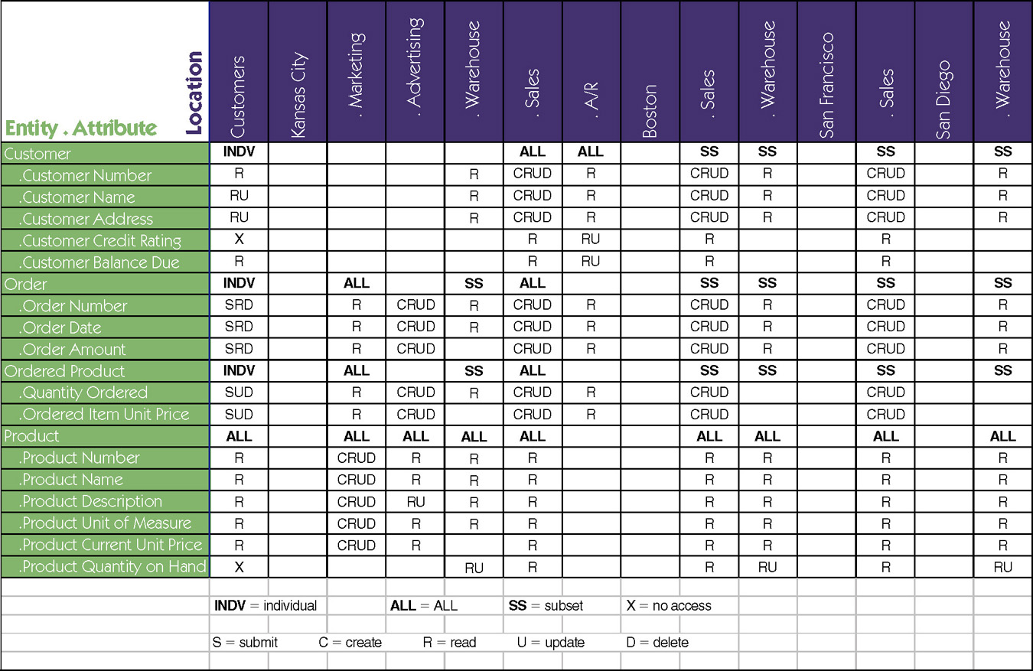
Data-to-Location-CRUD Matrix
Notes:
What does a data to location – CRUD (create, read, update, delete) matrix do?

Slide 13
Electronic Files
Sequential access files
Operations (read, write and search) are conducted one record after another (in sequence)
Efficient for report writing
Inefficient for searching (an average of 50% of records have to be accessed for each search)
Unordered files add records to the end of the file
Ordered files are sorted, but additions & deletions require additional maintenance
Random access files
Efficient for operations (read, write and search)
Inefficient for report writing
Notes:
How are a file and database different from each other?
What is required to combine data from different files?
What are the differences between sequential and random access files?

Slide 14
Application File Types
Master Files
Store core information (e.g., order and customer data)
Usually held for long periods
Changes require new programs
Look-up files (e.g., zip codes with city and state names)
Transaction files
Information used to update a master file
Can be deleted once master file is updated
Audit file—records data before & after changes
History file—archives of past transactions
Notes:
What is the primary purpose of master files?
What is the primary purpose of look up files?.
What is the primary purpose of transaction files?
What is the primary purpose of audit files?
What is the primary purpose of history files?

Slide 15
How are a file and database different from each other?

Slide 16
What are the differences between sequential and random access files?

Slide 17
What is the primary purpose of master files?

Slide 18
What is the role of a look-up file?

Slide 19
What is the role of a transaction file?

Slide 20
Object-Relational Databases
A relational database with ability to store objects
Accomplished using user-defined data types
SQL extended to handle complex data types
Support for inheritance varies
Notes:
What kind of data structures are supported / handled by traditional relational databases?
What is an object relational data base (ORDBMS)?
What is an example of a complex data structure?
Do all ORDMBS’s support inheritance?

Slide 21
NoSQL Data Stores
Newest type; used primarily for complex data types
Does not support SQL
No standards exist
Support very fast queries
Data may not be consistent since there are no locking mechanisms
Types
Key-value data stores
Document data stores
Columnar data stores
Immaturity of technology prevents traditional business application support
Notes:
What are the benefits of NoSQL Data Stores?
What are the shortfalls of NoSQL Data Stores?

Slide 22
Relational Databases
Most popular way to store data for applications
Consists of a collection of tables
Primary key uniquely identifies each row
Foreign keys establish relationships between tables
Referential integrity ensures records in different tables are matched properly
Example: you cannot enter an order for a customer that does not exist
Structured Query Language (SQL) is used to access the data
Operates on complete tables vs. individual records
Allows joining tables together to obtain matched data
Notes:
What is referential integrity?
What is an example of a use of referential integrity in a relational database?
Why are null values problematic in a relational database?
What is the most popular kind of database today?
What are some examples of popular relational databases?

Slide 23
Object-Oriented Databases
Two approaches:
Add persistence extensions to OO programming language
Create a separate OO database
Utilize extents—a collection of instances of a class
Each class is uniquely identified with an Object ID
Object ID is also used to relate classes together (foreign key not necessary)
Inheritance is supported but is language dependent
Represent a small market share due to its steep learning curve
Notes:
What are Object Orientated Database Management Systems (OODBMS)?
Have Object Orientated Database Management Systems (OODBMS) been accepted in the market?
What kinds of applications / markets have accepted OODBMS?
.

Slide 24
Explain the object persistence format type known as Relational databases.

Slide 25
What is the concept of referential integrity?

Slide 26
Why is referential integrity important in databases?

Slide 27
What is an example of a use of referential integrity in a relational database?

Slide 28
Why are null values problematic in a relational database?

Slide 29
Explain the object persistence format type known as Object-relational databases.

Slide 30
Do all ORDMBS’s support inheritance?

Slide 31
Explain the object persistence format type known as Object Oriented Databases.

Slide 32
What are the benefits of effective object persistence design?

Slide 33
What are the benefits of NoSQL Data Stores?

Slide 34
What are the shortfalls of NoSQL Data Stores?

Slide 35
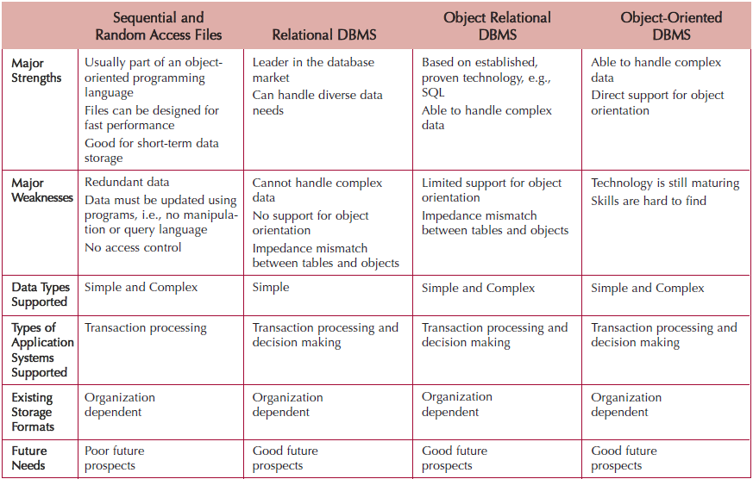
Selecting Persistence Formats
Notes:
What should you consider to determine the type of object persistence format you should use?
Why are these factors so important?
Why should you consider the storage formats that already exist in an organization when deciding upon a storage format for a new system?
What are the sequence of steps or approach you should use as when undertaking an object persistence design?

Slide 36
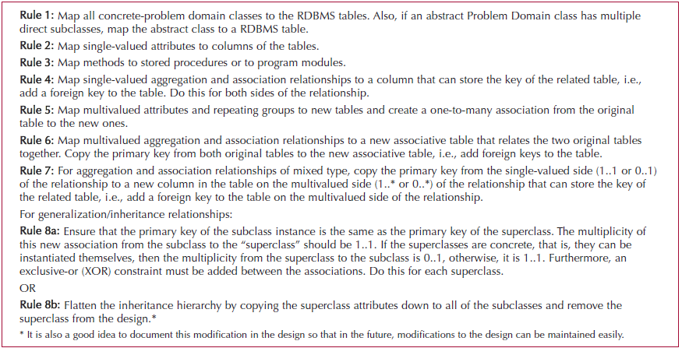
Mapping to an RDBMS
Notes:
When implementing objects in an RDBMS, what types of issues must you address?

Slide 37
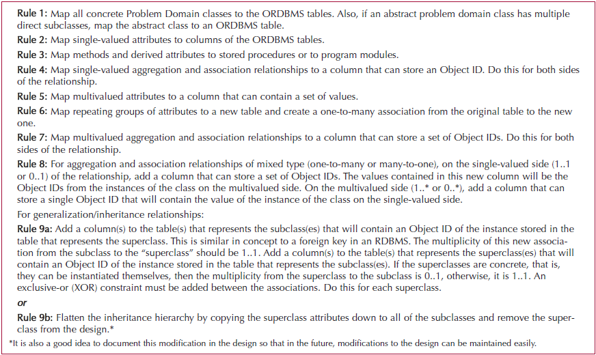
Mapping to an ORDBMS
Notes:
When implementing objects in an ORDBMS, what types of issues must you address?

Slide 38
Mapping Problem-Domain Objects to Object-Persistence Formats
Map objects to an OODBMS format
Each concrete class has a corresponding object persistence class
Add a data access and manipulation class to control the interaction
Map objects to an ORDBMS format
Procedure depends on the level of support for object orientation by the ORDBMS
Map objects to an RDBMS format
Notes:
List some of the differences between an ORDBMS and a RDBMS.
What are the advantages of using an ORDBMS over a RDBMS?
List some of the differences between an ORDBMS and an OODBMS?
What are the advantages of using an ORDBMS over an OODBMS?
What are the advantages of using an OODBMS over a RDBMS?
What are the advantages of using an OODBMS over an ORDBMS?

Slide 39
What should you consider to determine the type of object persistence format you should use?

Slide 40
Why should you consider the storage formats that already exist in an organization when deciding upon a storage format for a new system?

Slide 41
When implementing the object persistence in an RDBMS, what types of issues must you address?

Slide 42
When implementing objects in an ORDBMS, what types of issues must you address?

Slide 43
Describe the differences between an ORDBMS and an OODBMS

Slide 44
What are the advantages of using an ORDBMS over an OODBMS?

Slide 45
Optimizing RDBMS-Based Object Storage
Primary (often conflicting) dimensions:
Improve storage efficiency
Normalize the tables
Reduce redundant data and the occurrence of null values
Improve speed of access
De-normalize some tables to reduce processing time
Place similar records together (clustering)
Add indexes to quickly locate records
Notes:
How do you optimize a relational database?

Slide 46
How do you optimize a relational database?

Slide 47
Normalization: 1NF, 2NF, 3NF
First normal form (1NF) – entity whose attributes have no more than one value for a single instance of that entity
Any attributes that can have multiple values actually describe a separate entity, possibly an entity and relationship.
Second normal form (2NF) – entity whose nonprimary-key attributes are dependent on the full primary key.
Any nonkey attributes dependent on only part of the primary key should be moved to entity where that partial key is the full key. May require creating a new entity and relationship on the model.
Third normal form (3NF) – entity whose nonprimary-key attributes are not dependent on any other non-primary key attributes.
Any nonkey attributes that are dependent on other nonkey attributes must be moved or deleted. Again, new entities and relationships may have to be added to the data model.
Notes:
What is the purpose of normalization?

Slide 48
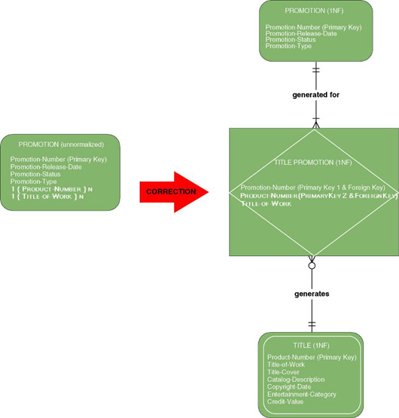
First Normal Form Example 2
Notes:
What is a repeating group?
How do you put an entity in its first normal form?
What was done in the diagram to put it in its 1 NF?

Slide 49
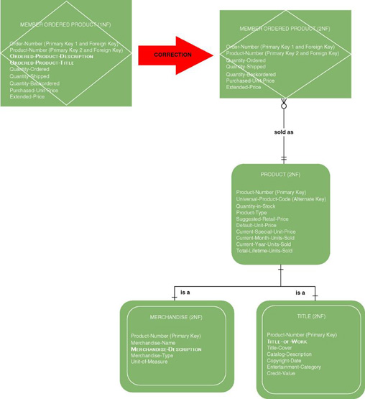
Second Normal Form Example 1
Notes:
After we have everything in the first normal form, we move onto the second normal form where we look for an attribute whose value is determined by only part of the primary key – not the entire compound key.
What form is “member ordered product” in & why?
Do you correct this by just removing “ordered product description” & “ordered product title” ?

Slide 50
Second Normal Form Example 1
Notes:
Do you correct this by just removing “ordered product description ” & “ordered product title” ?
What must we do before we move something to a super-type?

Slide 51
Second Normal Form Example 1
Notes:
What must we do before we move something to a super-type?
What happens when we inspect the entity “product’s” sub-types?

Slide 52
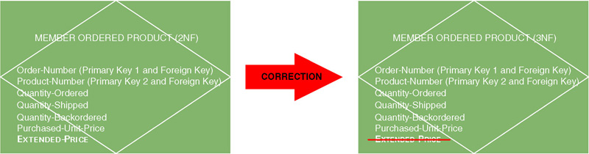
Third Normal Form Example 1
Derived attribute – an attribute whose value can be calculated from other attributes or derived from the values of other attributes.
Notes:
After we have everything in the 2NF we move to 3NF. What are some of the things the 3NF looks for?
What does the correction in this slide accomplish?

Slide 53
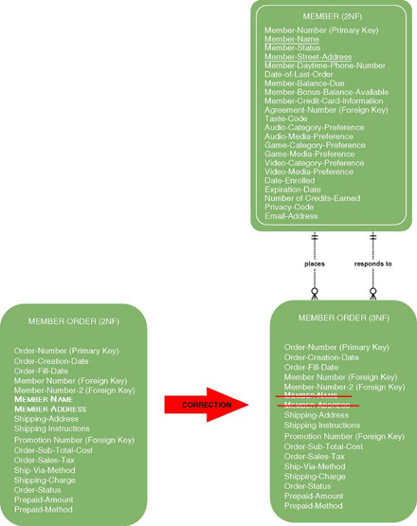
Third Normal Form Example 2
Transitive dependency – when the value of a nonkey attribute is dependent on the value of another nonkey attribute other than by derivation.
Notes:
After we have everything in the 2NF we move to 3NF. What else does the 3NF look for?
Transitive analysis is performed only on those entities that do not have a concatenated key. What do we know about “member name” and “member address” in “member order?”

Slide 54
What is the purpose of normalization?

Slide 55
Optimizing Data Access Speed
De-normalization
Table joins require processing
Add some data to a table to reduce the number of joins required (Increases data retrieval speed)
Creates redundancy and should be used sparingly
Clustering
Place similar records close together on the disk
Reduces the time needed to access the disk
Notes:
Why do we perform denormalization?
What are some situations that can be good candidates for denormalization.
What are the key issues in deciding between using perfectly normalized database and denormalized databases?
What is the difference between inter-file and intra-file clustering?
Why are they used?

Slide 56
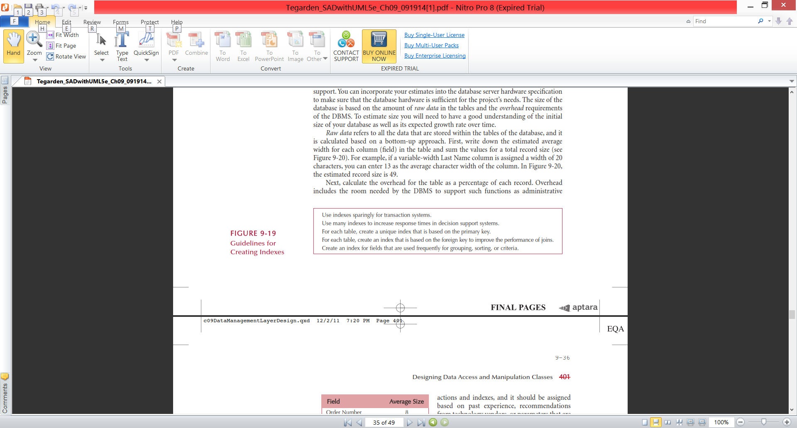
Optimizing Data Access Speed (cont.)
Indexing
A small file with attribute values and a pointer to the record on the disk
Search the index file for an entry, then go to the disk to retrieve the record
Accessing a file in memory is much faster than searching a disk
Notes:
Describe techniques that can improve performance of a database.

Slide 57
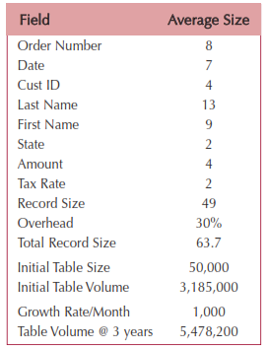
Optimizing Data Access Storage
Estimating Data Storage Size
Use volumetrics to estimate amount of raw data + overhead requirements
This helps determine the necessary hardware capacity
Notes:
Why is it important to properly estimation of the data set size?
What should you consider when estimating the size of a database?

Slide 58
Explain the term denormalization.

Slide 59
What are some situations that can be good candidates for denormalization?

Slide 60
What is clustering?

Slide 61
Why would an analyst both normalize and denormalize the design of the data management layer?

Slide 62
What does Inter-file clustering do?

Slide 63
Explain the term Indexing

Slide 64
What is Volumetrics?

Slide 65
Designing Data Access & Manipulation Classes
Classes that translate between the problem domain classes and object persistent classes
ORDBMS: create one DAM for each concrete PD class
RDBMS: may require more classes since data is spread over more tables
Class libraries (e.g., Hibernate) are available to help
Notes:
What is the primary purpose of the data access and manipulation classes?

Slide 66
Nonfunctional Requirements & Data Management Layer Design
Operational requirements: affected by choice in hardware and operating system
Performance requirements: speed & capacity issues
Security requirements: access controls, encryption, and backup
Cultural & political requirements: may affect the data storage (e.g., expected number of characters for data field, required format of a data field, local laws pertaining to data storage, etc…)
Notes:
What are nonfunctional requirements?
Given a mobile computing environment, can non functional requirements like multi platform, sped & capacity influence the design of the data management layer?
Why should data access and manipulation classes be dependent on the associated problem domain classes instead of the other way around?

Slide 67
VERIFYING AND VALIDATING THE DATA MANAGEMENT LAYER
Test the fidelity of the design before implementation
Verifying and validating the design of the data management layer falls into three basic groups:
Verifying and validating any changes made to the problem domain
Dependency of the object persistence instances on the problem domain must be enforced
The design of the data access and manipulation classes need to be tested
Notes:
Why is verifying & validating the data management layer important?
What are some techniques can you use to verify & validate the data management layer?

Slide 68
How does the management layer resolve the conflict of users demand for maximum or fast access to objects (their data) (system as too slow) & project funders demands for minimum storage space (low cost)?

Slide 69
Why should the object database be dependent on the associated problem domain classes instead of the other way around?

Slide 70
What are some techniques can you use to verify & validate the data management layer?

Slide 71
SQL operates on _____.
a. rows of data at a time
b. columns of data at a time
c. tables of data at a time
d. the entire database
e. any of the above

Slide 72
The type of database that is most capable of supporting complex data types is _____.
a. sequential files
b. relational DBMS
c. object-oriented DBMS
d. object-relational DBMS
e. random access files

Slide 73
The process of ensuring that values linking tables together through the primary and foreign keys are valid and correctly synchronized is _____.
a. hierarchical integrity
b. primary integrity
c. table integrity
d. referential unity
e. referential integrity

Slide 74
If the logical data model contains fields that depend on another non-primary key field, then it is in violation of the rules of _____.
a. base normal form
b. first normal form
c. non-normal form
d. second normal form
e. third normal form

Slide 75
_____ is the process of estimating the amount of data that the hardware will need to support, so that the server hardware specifications are sufficient for the project’s needs.
a. Indexing
b. Interfile clustering
c. Intrafile clustering
d. Raw data calculating
e. Volumetrics

Slide 76
A master file holds information temporarily so that it can be used to update other master files.
T / F

Slide 77
Update anomalies occur when some instances of redundantly stored data are overlooked when an update occurs.
T / F

Slide 78
Clustering similar records together is one way of reducing access time.
T / F

Slide 79
Information in a file's records that specifies the location of related records is called a marker.
T / F

Slide 80
When the analyst is evaluating a data model to ensure that all fields in a record depend fully on the entire primary key, the analyst is making sure that the data model conforms to the second normal form.
T / F

Slide 81
Read class handout
(Drew & Becky)
What object persistence format would you recommend to Becky and Drew?

Slide 82
How can denormalization reduce joins and improve data access performance?

Slide 83
Mini Case
Read
(Class Handout
Ag Credit)

Slide 84
What issues must the new organizational structure for the IT department address to support the transformation of AgCredit into a process-centric organization.
Outline a project selection process for AgCredit to ensure alignment with the enterprise business vision.
How should Manley “make the case” for SOA to ensure that the executive team at AgCredit buys in?
What new internal IT capabilities will have to be developed in order to create an IT department to support AgCredit’s future business architecture?

Slide 85
What issues must the new organizational structure for the IT department address to support the transformation of AgCredit into a process-centric organization.

Slide 86
Outline a project selection process for AgCredit to ensure alignment with the enterprise business vision.

Slide 87
How should Manley “make the case” for SOA to ensure that the executive team at AgCredit buys in?

Slide 88
What new internal IT capabilities will have to be developed in order to create an IT department to support AgCredit’s future business architecture?

